Slide 1
Information Asset Security
Sonika Verma
CSCD92: Week 04

Slide 2
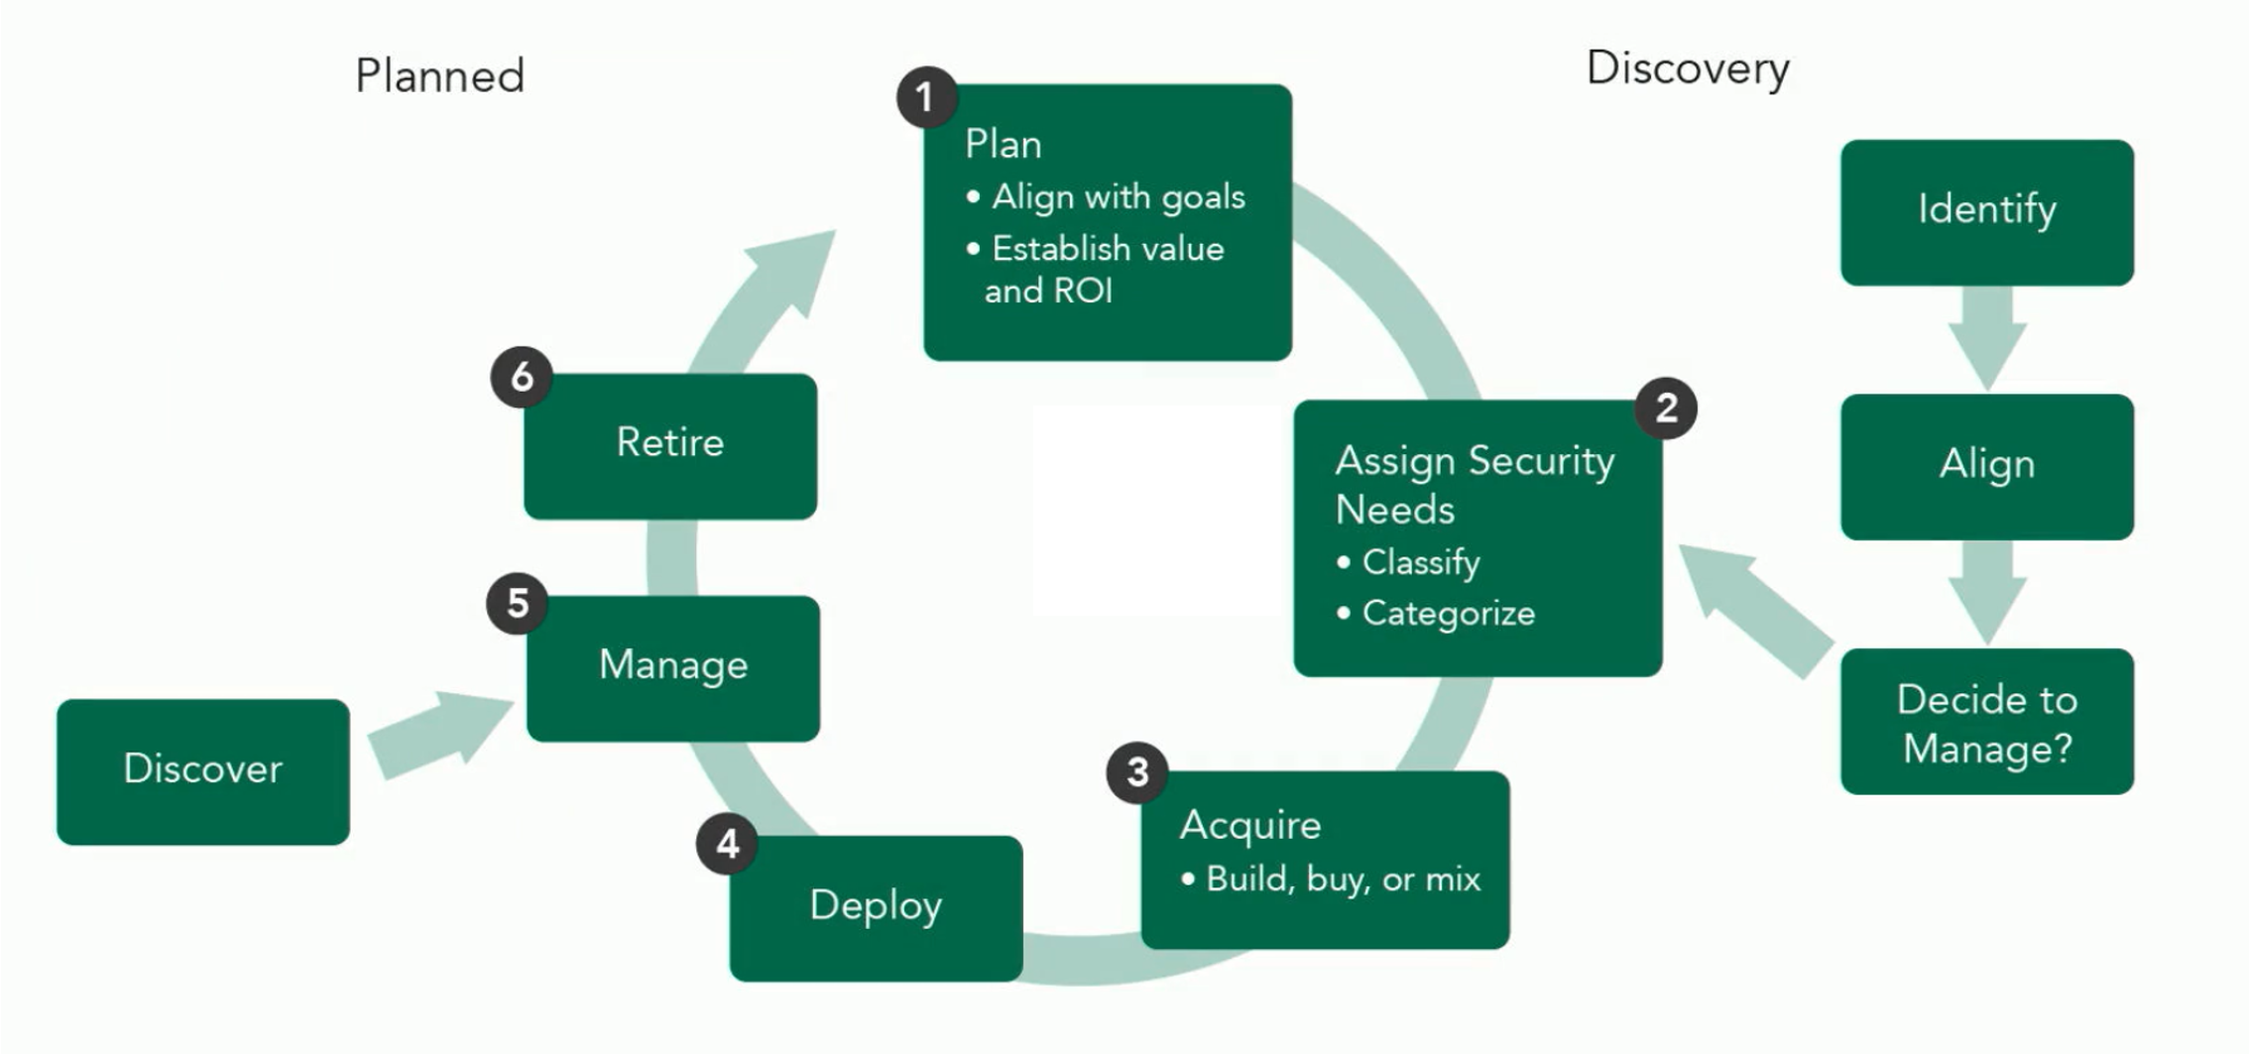
Information Technology & Assets
Materials + Supplies > Assets > Outcomes
Tangible vs. Intangible assets
IT Asset Management Lifecycle

Slide 3
Information Security Management Activities
Planning
Assign Security Needs
Acquiring the Asset
Deployment
Management
Retirement

Slide 4
Information Asset Inventory
Identify sets of information as input and produced outputs
Process control data
Networks and systems security information and monitoring data
Customer transaction data
Information and asset ownership
Information owner

Slide 5
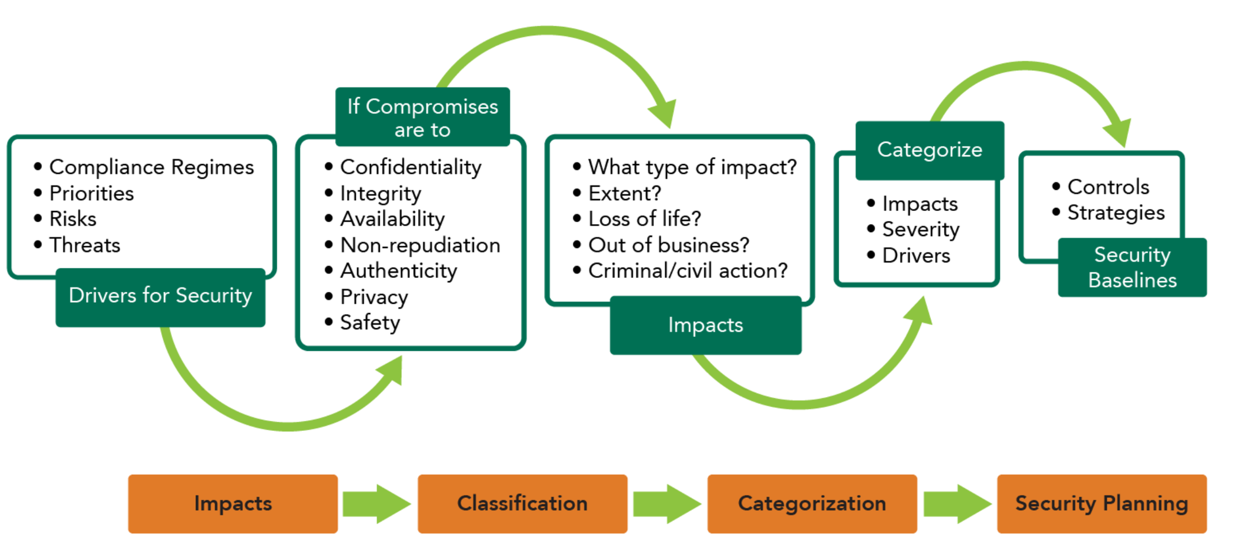
Information Asset Inventory
Classification
Categorization
Understanding value

Slide 6
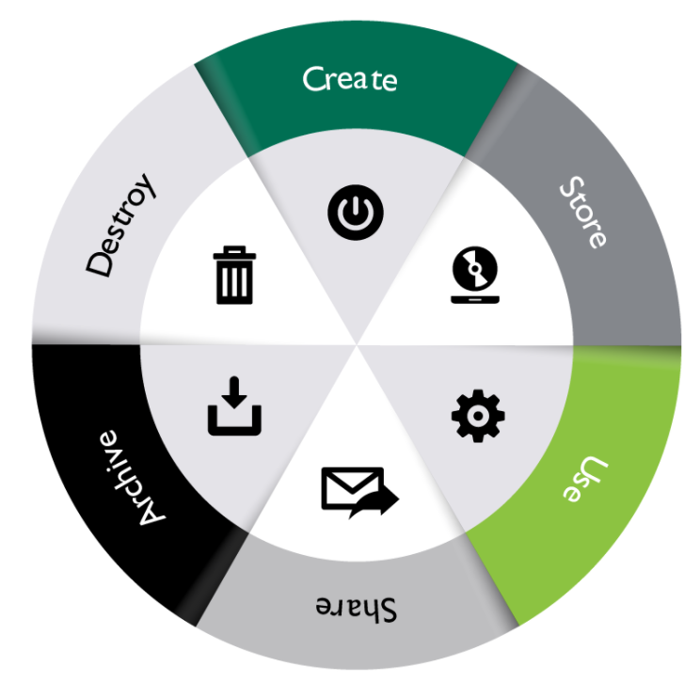
Data Security Lifecycle
Create
Store
Use
Share
Archive
Destroy
Identify and classify, secure, monitor, recover, disposition, archive, defensible destruction

Slide 7
Delineating Data Management
Media handling
Roles and responsibilities
Data owner
Data custodian
Data controller
Data steward

Slide 8
Data States
Data at rest
Data in motion / transit
Data in use
Risks & Recommendations

Slide 9
Data, Data & Data
Data collection
Data location
Data retention
Data remanence
Data destruction
End-of-Life / End-of-Support

Slide 10
Data Security Controls & Compliance Requirements
Administrative controls
Technical / logical controls
Physical controls
Standards selection
PCIDSS, ISO, GDPR…
International/National/Sector regulations
Organization/Industry recommendations

Slide 11
Baseline
Minimum level of protection
Specified safeguards
Consistency
Cost-effective solution
Scoping
Tailoring
Supplementation

Slide 12
Generally Accepted Principles
Information system security objectives
Prevent, detect, respond, and recover
Protection of information at rest, in process, in transit
External systems assumed unsecure
Resilience for critical information systems
Auditability and accountability

